Slide 1

Generative AI Technology for Testing Automation
Use Case - 1: Duplicate Defect Identification

Slide 2

AGENDA
INTRODUCTION Slide 3
APPROACH Slides 4
CASE STUDY-1 Slides 5 to 9
CASE STUDY-2 Slides 10 to 12
EFFORT ESTIMATION Slides 13

Slide 3

3
Duplicate Defect Identification - Introduction
According to a study conducted by Capers Jones, a renowned software engineering expert, duplicate defects account for approximately 20-25% of all reported software defects. This means that one out of every four to five reported bugs is a duplicate of an existing issue.​
A duplicate bug or defect refers to an issue or problem that has been reported multiple times within a software development or testing process. It occurs when two or more individuals identify and report the same bug independently.​
Duplicate defects leads to Redundancy and waste of resources​, Confusion and inefficiency​, Delayed bug fixing​, Decreased productivity​, and Inaccurate bug metrics​
Duplicate bug detection ensures
Consistency: Ensures consistent bug reporting and tracking, avoiding redundant efforts and improving resource allocation.​
Efficiency: Identifying similar bugs streamlines bug management, allowing developers to focus on unique issues and enhancing overall productivity.​
Quality Assurance: Detecting duplicate bugs helps uncover patterns and root causes, enabling informed decisions for software improvement and reliability.​

Slide 4




4
Duplicate Defect Identification Using Gen AI - Approach
Review
Original Defects
Defect Log
Gen AI (LLM)
Test Engineer
Gen AI (LLM)
Duplicate Defect Relational Table
Flag all the duplicate defect sentences and form a table
Review
Choose the best defect description in each group
Duplicate Defects
Prompt
Prompt
*** ***
Parsing Instruction
Final Defects Log
Prompt Engineer
*LLM – Large Language Model

Slide 5

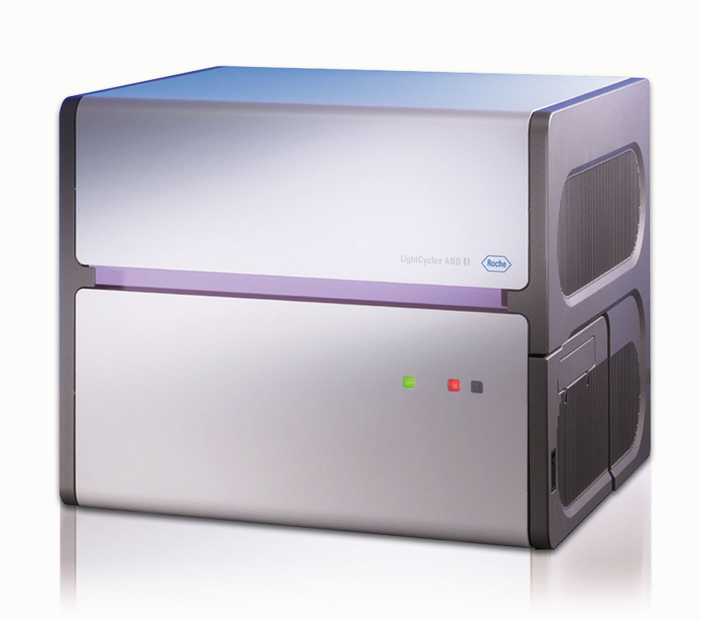



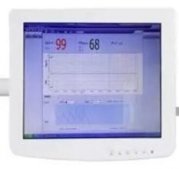
5
Case Study-1: Device Description – Blood Sample Analyzer
Instrument Software
External Monitor
Operator
Keyboard
Mouse
Blood Sample Analyzer
Operator
Touch Screen
Blood sample analyzer is medical device used to diagnose the blood samples
Runs tests on the blood samples based on the instructions from the operator and generates a report
Instrument software
used to get instructions from the operator, execute the test procedure, and display the report
Interfaces UI touch screen and provides options to interface external keyboard, mouse, and monitor for extended operations

Slide 6
6
Sample Defects - Instrument Software
Defect. ID | Defect Description
MED_IS_DEF01 | When the device has started “Main” text is not visible on the display screen
MED_IS_DEF02 | After pressing F4 no display is available, and no prompt box appeared
MED_IS_DEF03 | Not able to enter four-digit serial number in serial number field
MED_IS_DEF04 | Main text display is missing in screen after the device has started
MED_IS_DEF05 | Function button F4 is not able to prompt to save the configuration
MED_IS_DEF06 | No screen response is observed after pressing the function F4 button
MED_IS_DEF07 | Started the device and checked for display. No “Main” text is visible
MED_IS_DEF08 | On pressing ‘Y’ key no message is displayed after entering serial number
Description:
MED_IS_DEF01, MED_IS_DEF04, MED_IS_DEF07 – Conveys same defects (Main text missing) in different formats
MED_IS_DEF02, MED_IS_DEF06 – Conveys about missing prompt
MED_IS_DEF05 – looks similar with MED_IS_DEF02, MED_IS_DEF06 but conveys about missing information
MED_IS_DEF03 – conveys defects on digit requirements
MED_IS_DEF08 – conveys defect on confirmation text

Slide 7
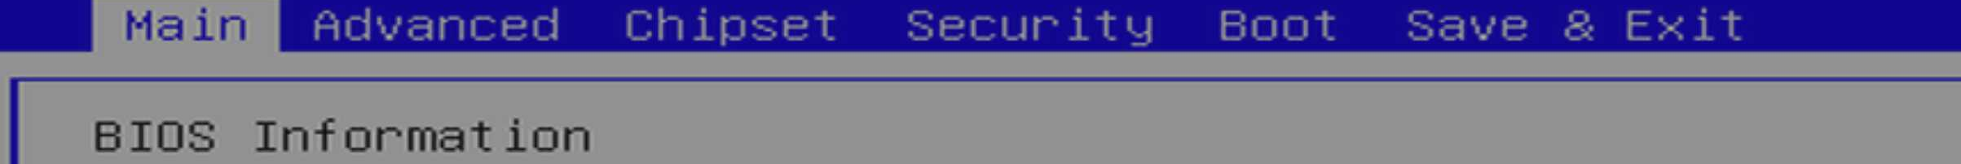
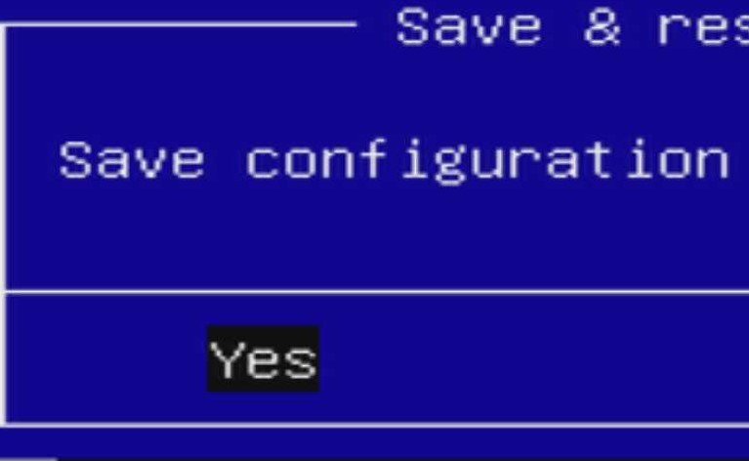

7
Sample Display Screen – Blood Sample Analyzer Instrument Software
(1) Main Menu Screen
(2) Save Prompt for F4
(3) Serial Number Screen

Slide 8
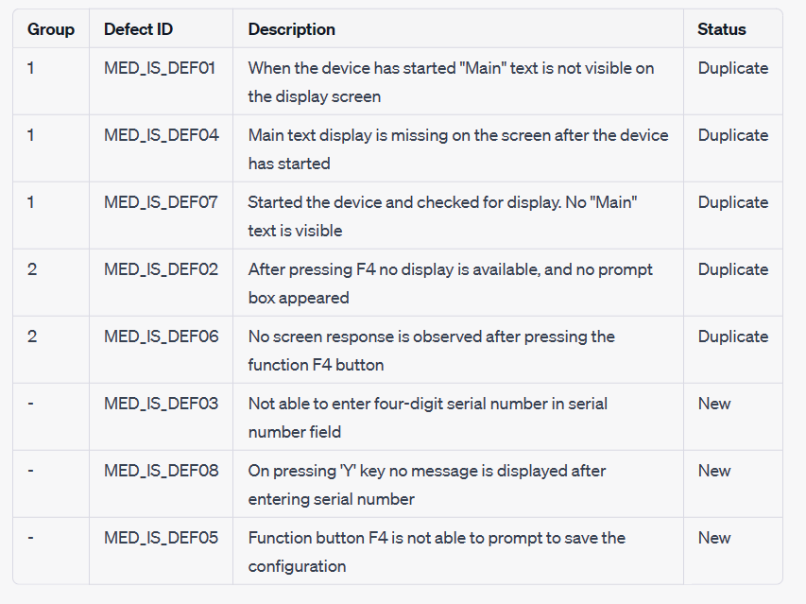
8
Defect Relational Table Creation Using Gen AI
Output:
Prompt:
Group all the duplicate defects from the given defects in table form. Mention it as duplicate or new defect. Also mention group number as one column only for duplicate defects and no group number for new defects.

Slide 9
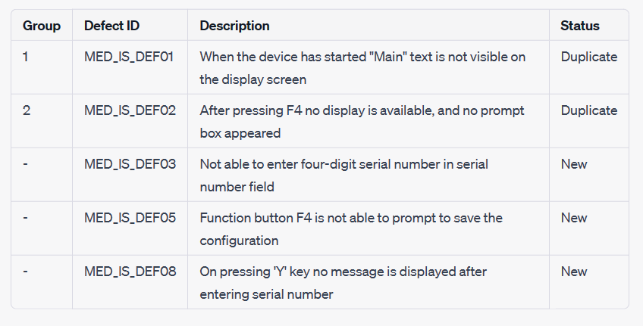
9
Duplicate Defect Removal Using Gen AI
Output:
Prompt:
Choose the best defect description in each group and retain them in the table. Remove the remaining duplicate defects from each group and present the new table.

Slide 10
10
Case Study-2: Duplicate Bug Detection – Mozilla Firefox Dataset
Defect_id​ | Title​ | Description​
352611​ | Firefox keep defaulting everytime it is open and close. Bookmark is missing and cant add search engine.​ | User-Agent: Mozilla/5.0 (Windows; U; Windows NT 5.1; en-US; rv:1.8.0.6) Gecko/20060728 Firefox/1.5.0.6; Build Identifier: Mozilla/5.0 (Windows; U; Windows NT 5.1; en-US; rv:1.8.0.6) Gecko/20060728 Firefox/1.5.0.6; ; Firefox keeps defaulting to original setting every time it is open and close. Also; my bookmark seems to disappeared and I cant add search engines either.; ; …​
358212​ | bookmarks not present after upgrade to 2.0​ | User-Agent: Mozilla/5.0 (Windows; U; Windows NT 5.1; en-US; rv:1.8.0.7) Gecko/20060909 Firefox/2.0; Build Identifier: Mozilla/5.0 (Windows; U; Windows NT 5.1; en-US; rv:1.8.0.7) Gecko/20060909 Firefox/2.0; ; Upgraded to Firefox 2.0. No bookmarks present even though sidebar is open. If I import from IE; I get the bookmarks from previous Firefox; but when I click on them NOTHING happens. Ive shut down Firefox and relaunched. Ive run using -Profile; etc. Ive rebooted computer. Each time I open Firefox bookmarks arent present. ; ; Reproducible: Always​
172962​ | Options for where to open URLs from other applications (reuse tab; new tab; new window)​ | User-Agent: Mozilla/5.0 (Windows; U; Windows NT 5.1; en-US; rv:1.2b) Gecko/20021006 Phoenix/0.3; Build Identifier: Mozilla/5.0 (Windows; U; Windows NT 5.1; en-US; rv:1.2b) Gecko/20021006 Phoenix/0.3; ; Tbis is a dupe of http://bugzilla.mozilla.org/show_bug.cgi?id=75138 (for; of the two (open a; new tab in an existing window).; ; Right now its pretty much random for me. Some…​
646300​ | flash keeps crashing.​ | User-Agent: Mozilla/5.0 (Windows; U; Windows NT 5.1; en-US; rv:1.9.2.16) Gecko/20110319 Firefox/3.6.16 ( .NET CLR 3.5.30729; .NET4.0C) Search Toolbar/1.2; Build Identifier: Mozilla/5.0 (Windows; U; Windows NT 5.1; en-US; rv:1.9.2.16) Gecko/20110319 Firefox/3.6.16 ( .NET CLR 3.5.30729; .NET4.0C) Search Toolbar/1.2; ; I try to watch Hulu.com or ATT Uverse On-Line and the Flash keeps crashing. There is…​
172530 | url drop-down box appears to the left of the url bar | User-Agent: Mozilla/5.0 (Windows; U; Windows NT 5.1; en-US; rv:1.2b) Gecko/20021003 Phoenix/0.3; Build Identifier: Mozilla/5.0 (Windows; U; Windows NT 5.1; en-US; rv:1.2b) Gecko/20021003 Phoenix/0.3; ; If you customize the toolbar to create a new toolbar and move the address field; to that toolbar and the GO button is not to the immediate right of the address; bar field; the autocomplete dropdown appears off the screen to the left. This; happens if the GO button is completely removed from the toolbars as well. ; ; Reproducible: Always;…
206102 | Address bar - the drop down list of previously visited websites is aligned wrongly | User-Agent: Mozilla/5.0 (Windows; U; Windows NT 5.0; en-US; rv:1.4b) Gecko/20030516 Mozilla Firebird/0.6; Build Identifier: Mozilla/5.0 (Windows; U; Windows NT 5.0; en-US; rv:1.4b) Gecko/20030516 Mozilla Firebird/0.6; ; When clicking on the menu bar in Mozilla Firebird 0.6 to view the list of; previously visited websites; the drop down list showing these websites is; aligned incorrectly. The right hand edge of the drop down list is aligned with;…
207594 | url editor hint is shirfted to left | User-Agent: Mozilla/5.0 (Windows; U; Windows NT 5.0; en-US; rv:1.4b) Gecko/20030516 Mozilla Firebird/0.6; Build Identifier: Mozilla/5.0 (Windows; U; Windows NT 5.0; en-US; rv:1.4b) Gecko/20030516 Mozilla Firebird/0.6; ; when there is only one element on tool bar(Location) and only one tool bar. Then; when u type url; hint with previously visited urls is shifted to left. If;; forexample; add flexible space on toolbar; all is OK.; ; Reproducible: Always;…

Slide 11
Defect Relational Table Creation Using Gen AI
Group ID | Defect ID | Summary
1 | 352611, 358212 | Firefox keeps defaulting to original settings
 |  | Bookmarks missing; cannot add search engines
2 | 172962 | Inconsistent options for opening URLs from other applications
3 | 646300 | Flash keeps crashing in Firefox
4 | 172530, 206102, 207594 | Alignment and display issues with URL dropdown and address bar
Prompt:
***
Defects…
***
Here is the list of defects separated by three asterisks mark, I want to identify the duplicate defects and group them as one in a table form with group id, defect id and summary.

Slide 12
Duplicate Defect Removal Using Gen AI
Group ID | Defect ID | Summary
1 | 352611 | Firefox keeps defaulting to original settings
2 | 172962 | Inconsistent options for opening URLs from other applications
3 | 646300 | Flash keeps crashing in Firefox
4 | 172530 | Alignment issue with URL dropdown list
Prompt:
Here, from above table choose the best defect description in each group of a particular issue and retain them in the table. Remove the remaining duplicate defects from each group and present the new table.

Slide 13
13
Effort Estimation
No. of Defects: 10
Manual Based Approach
Generative AI Based Approach
Activity | Effort in PH
Understanding defects (0.1 PH/Test Case) | 1
Finding similarities among defects & grouping | 2
Removing duplicate defects & update | 0.5
Review | 0.5
Total: | 4 PH
Activity | Effort in PH
Data set preparation | 0.5
Prompt engineering | 0.5
Grouping defects (Gen AI) | 0.1
Removing duplicate defects (Gen AI) | 0.1
Review | 0.5
Total: | 1.7 PH
*PH – Person Hours
~58% Reduction in manual effort using generative AI technology

Slide 14
14
Next Step..
Quantitively analysis of similarity/differences across defects
Data Analytics on frequently occurring defects
Generative AI to reason out the duplicate defects

